Slide 1
Propositional Logic

Slide 2

Conditional Statement
If p then q
p is called the hypothesis; q is called the conclusion
The department says:
“If your GPA is 4.0, then you don’t need to pay tuition fee.”
When is the above sentence false?
It is false when your GPA is 4.0 but you still have to pay tuition fee.
But it is not false if your GPA is below 4.0.

Slide 3



Logic Operator
P
Q
P Q
T
T
T
T
F
F
F
T
T
F
F
T
Convention: if we don’t say anything wrong, then it is not false, and thus true.

Slide 4
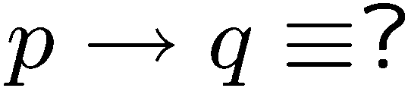
Logical Equivalence
If you see a question in the above form,
there are usually 3 ways to deal with it.
Truth table
Use logical rules
Intuition

Slide 5


If-Then as Or
P
Q
P Q
Idea 2: Look at the false rows,
negate and take the “and”.
T
T
T
T
F
F
F
T
T
F
F
T
If you don’t give me all your money, then I will kill you.
Either you give me all your money or I will kill you (or both).
If you talk to her, then you can never talk to me.
Either you don’t talk to her or you can never talk to me (or both).

Slide 6
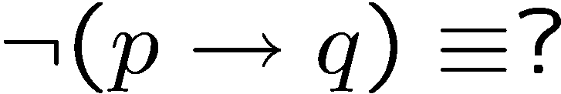




Negation of If-Then
If your GPA is 4.0, then you don’t need to pay tuition fee.
Your term GPA is 4.0 and you still need to pay tuition fee.
If my computer is not working, then I cannot finish my homework.
My computer is not working but I can finish my homework.
previous slide
DeMorgan

Slide 7
Contrapositive
The contrapositive of “if p then q” is “if ~q then ~p”.
Statement: If you are a CS year 1 student,
then you are taking CS203.
Contrapositive: If you are not taking CS203,
then you are not a CS year 1 student.
Statement: If x² is an even number,
then x is an even number.
Contrapositive: If x is an odd number,
then x² is an odd number.
Fact: A conditional statement is logically equivalent to its contrapositive.

Slide 8










Proofs
Statement: If P, then Q
Contrapositive: If Q, then P.
T | T | T
T | F | F
F | T | T
F | F | T
F | F | T
T | F | F
F | T | T
T | T | T

Slide 9
If, Only-If
You will succeed if you work hard.
You will succeed only if you work hard.
R if S means “if S then R” or equivalently “S implies R”
We also say S is a sufficient condition for R.
R only if S means “if R then S” or equivalently “R implies S”
We also say S is a necessary condition for R.
You will succeed if and only if you work hard.
P if and only if (iff) Q means P and Q are logically equivalent.
That is, P implies Q and Q implies P.

Slide 10





Math vs English
Parent: if you don’t clean your room, then you can’t watch a TV.
C
D
This sentence says
So
In real life it also means
Mathematician: if a number x greater than 2 is not an odd number,
then x is not a prime number.
This sentence says
But of course it doesn’t mean

Slide 11
Necessary, Sufficient Condition
Mathematician: if a number x greater than 2 is not an odd number,
then x is not a prime number.
This sentence says
But of course it doesn’t mean
Being an odd number > 2 is a necessary condition for this number to be prime.
Being a prime number > 2 is a sufficient condition for this number to be odd.

Slide 12





Necessary AND Sufficient Condition
P
Q
P Q
T
T
T
T
F
F
F
T
F
F
F
T
Note: P Q is equivalent to (P Q) (Q P)
Note: P Q is equivalent to (P Q) ( P Q)
Is the statement “x is an even number if and only if x² is an even number” true?

Slide 13

Argument
An argument is a sequence of statements.
All statements but the final one are called assumptions or hypothesis.
The final statement is called the conclusion.
An argument is valid if:
whenever all the assumptions are true, then the conclusion is true.
If today is Wednesday, then yesterday was Tuesday.
Today is Wednesday.
Yesterday was Tuesday.

Slide 14
Modus Ponens
If p then q.
p
q
If bandh, then class cancelled.
Bandh.
Class cancelled.
assumptions
conclusion
p | q | p→q | p | q
T | T | T | T | T
T | F | F | T | F
F | T | T | F | T
F | F | T | F | F
Modus ponens is Latin for “method of affirming”.

Slide 15
Modus Tollens
If p then q.
~q
~p
If Bandh, then class cancelled.
Class not cancelled.
No Bandh.
assumptions
conclusion
p | q | p→q | ~q | ~p
T | T | T | F | F
T | F | F | T | F
F | T | T | F | T
F | F | T | T | T
Modus tollens is Latin for “method of denying”.

Slide 16
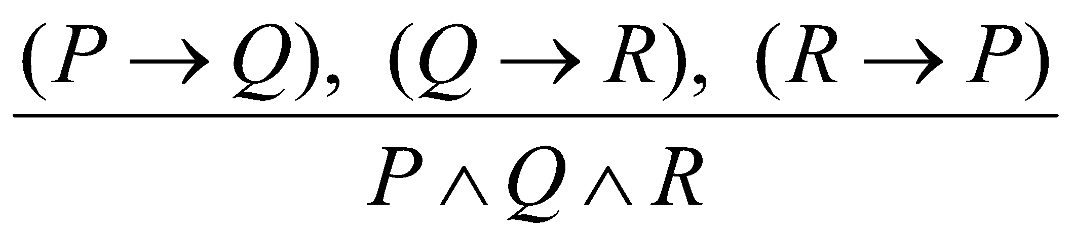
Equivalence
A student is trying to prove that propositions P, Q, and R are all true.
She proceeds as follows.
First, she proves three facts:
P implies Q
Q implies R
R implies P.
Then she concludes,
``Thus P, Q, and R are all true.''
Proposed argument:
assumption
Is it valid?
conclusion

Slide 17




Valid Argument?
Is it valid?
assumptions
conclusion
P | Q | R
T | T | T
T | T | F
T | F | T
T | F | F
F | T | T
F | T | F
F | F | T
F | F | F
T | T | T
T | F | T
F | T | T
F | T | T
T | T | F
T | F | T
T | T | F
T | T | T
 | OK?
T | yes
F | yes
F | yes
F | yes
F | yes
F | yes
F | yes
F | no
To prove an argument is not valid, we just need to find a counterexample.

Slide 18
Valid Arguments?
assumptions
conclusion
p | q | p→q | q | p
T | T | T | T | T
T | F | F | F | T
F | T | T | T | F
F | F | T | F | F
If p then q.
q
p
Assumptions are true, but not the conclusion.
If you are a fish, then you drink water.
You drink water.
You are a fish.

Slide 19
Valid Arguments?
assumptions
conclusion
p | q | p→q | ~p | ~q
T | T | T | F | F
T | F | F | F | T
F | T | T | T | F
F | F | T | T | T
If p then q.
~p
~q
If you are a fish, then you drink water.
You are not a fish.
You do not drink water.

Slide 20


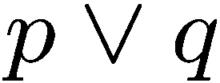
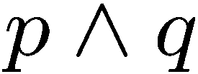



Exercises

Slide 21




More Exercises
Valid argument True conclusion
True conclusion Valid argument

Slide 22

Contradiction
If you can show that the assumption that the statement
p is false leads logically to a contradiction,
then you can conclude that p is true.
You are wearing a jacket.
If it was warm, then you would not have worn a jacket.
It is not warm.

Slide 23
Knights and Knaves
Knights always tell the truth.
Knaves always lie.
A says: B is a knight.
B says: A and I are of opposite type.
Suppose A is a knight.
Then B is a knight (because what A says is true).
Then A is a knave (because what B says is true)
A contradiction.
So A must be a knave.
So B must be a knave (because what A says is false).

Slide 24
Quick Summary
Conditional Statements
The meaning of IF and its logical forms
Contrapositive
If, only if, if and only if
Arguments
definition of a valid argument
method of affirming, denying, contradiction
Key points:
Make sure you understand conditional statements and contrapositive.
Make sure you can check whether an argument is valid.

Slide 25
Which is true?
Which is false?
“The sentence below is false.”
“The sentence above is true.”

